Slide 1
Zone-wise PQC and QKD for SMR control systems
M.Sc. THESIS PROPOSAL · REVISED APPROACH
Where does post-quantum cryptography suffice, and where does QKD add measurable value?

Slide 2
Why the approach changed
Wrong threat model
Attacks crypto cannot stop
Weak comparison
Nuclear I&C ranks availability and integrity above confidentiality. The urgent quantum risk is firmware roots of trust and long-retention data.
Process-level attacks and Stuxnet-type malware bypass link encryption, so they cannot judge a cryptographic choice.
RSA/AES baseline, QKD-only without authentication, and an index with arbitrary weights.

Slide 3
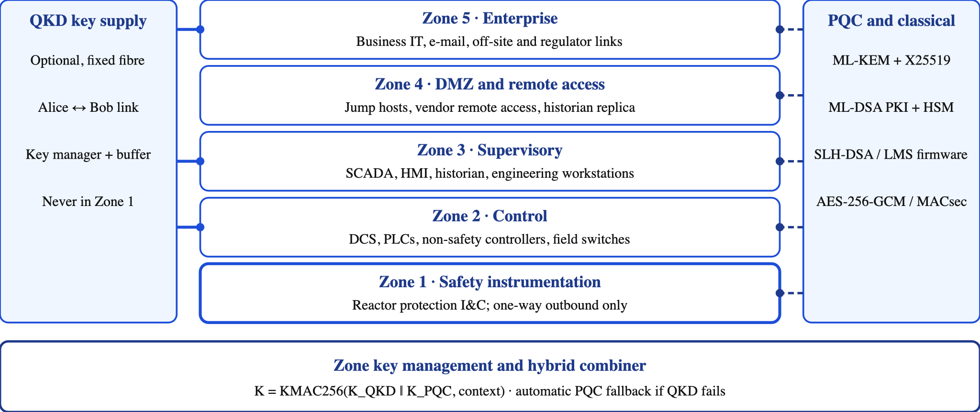
High-level architecture

Slide 4
The five zones
Zone | Typical assets | Trust and data flow | Crypto role
Z1 Safety | Reactor protection, safety I&C | Most trusted; one-way outbound | Signed firmware; pre-shared keys
Z2 Control | DCS, PLCs, field switches | Controlled flow from Z1 | MACsec at boundaries
Z3 Supervisory | SCADA, HMI, historian | Operators and engineers | Hybrid key exchange; signed commands
Z4 DMZ / remote | Jump hosts, vendor access | Brokered, untrusted callers | Hybrid KEM; ML-DSA PKI
Z5 Enterprise | Business IT, regulator links | Least trusted | Hybrid TLS; optional QKD link

Slide 5
Threat surfaces of a nuclear ICS
Remote access
IT/OT boundary
Engineering endpoints
Vendor support, remote monitoring and operations links crossing the DMZ.
Historians, enterprise networks and data gateways between zones.
Maintenance laptops, USB media and engineering workstations that reach controllers.
Supply chain and firmware
Field and network layer
Data and insiders
Digital I&C, FPGA logic and updates with 40–60-year lifetimes.
Switches, fibre taps, wireless links and unauthenticated protocols such as Modbus.
Design, safeguards and physical-protection data; privileged staff and physical access.

Slide 6
What PQC and QKD can and cannot reach
PQC helps with
QKD helps with
Not solved by crypto
Identity and mutual authentication (ML-DSA), signed firmware (SLH-DSA/LMS), key exchange (ML-KEM) that stays safe against quantum attack.
Fresh symmetric keys on fixed fibre links, and long-term confidentiality for selected flows. It still needs authentication.
Compromised endpoints, USB and insider misuse, process-logic attacks, firmware compromised before signing, and denial of service.

Slide 7
STRIDE analysis (1 of 2)
Threat | Nuclear ICS example | PQC | QKD | Still needed
Spoofing | Rogue device or vendor impersonation | ML-DSA mutual authentication, quantum-safe identity | No direct help; needs authenticated channel | Device allowlisting, MFA
Tampering | Setpoint injection, replay, forged firmware | Signed firmware (SLH-DSA/LMS), authenticated encryption | Fresh keys for message authentication | Data diodes, process-level checks
Repudiation | Disputed commands or maintenance actions | ML-DSA signatures on commands and logs | None: symmetric keys cannot prove origin | Audit logging, time sync
Notes:
S, T, R. QKD gives no non-repudiation.

Slide 8
STRIDE analysis (2 of 2)
Threat | Nuclear ICS example | PQC | QKD | Still needed
Information disclosure | Eavesdropping; harvest-now-decrypt-later of design and safeguards data | Hybrid ML-KEM key exchange | Seeds keys for long-confidentiality fixed links | Data classification, retention limits
Denial of service | Flooding; key-supply loss; fibre cut or alarm | Adds handshake load; larger packets | Alarm or fibre cut stops key supply | PQC fallback, redundancy, rate limits
Elevation of privilege | Rogue engineering workstation or stolen credentials | Role-bound certificates, signed commands | None | Least privilege, segmentation
Notes:
I, D, E. Crypto can create new availability risks.

Slide 9
Dominant threats and response by zone
Zone | Dominant STRIDE threats | Cryptographic response
Z1 Safety | Tampering, denial of service | No remote keys; data diode; signed firmware
Z2 Control | Spoofing, tampering, DoS | MACsec at boundaries; PQC fallback
Z3 Supervisory | Spoofing, tampering, repudiation, elevation | ML-DSA authentication; signed commands and logs
Z4 DMZ / remote | Spoofing, disclosure, elevation, DoS | Hybrid KEM; ML-DSA PKI
Z5 Enterprise | Disclosure, spoofing, repudiation | Hybrid TLS; QKD-seeded links where fibre is fixed

Slide 10
One question, five setups
For each IEC 62443 zone, which profile meets the target security level within the control-loop delay margin, key-supply limits and regulatory constraints?
1 | 2 | 3 | 4 | 5
Plaintext legacy | Classical ECDHE + AES-256 | PQC-only | Classical + PQC | PQC + QKD-seeded keys

Slide 11
Key management by zone
Zone | Cryptographic profile
Z1 Safety | One-way data diode, no remote keys, pre-shared AES-256, PQC-signed firmware. No QKD.
Z2 Control | MACsec AES-256 at boundaries, PLCs unmodified; QKD-seeded keys with PQC fallback
Z3 Supervisory | IKEv2 with ML-KEM plus QKD-seeded key; OPC UA via gateway
Z4 DMZ / remote | Hybrid X25519 + ML-KEM-768, ML-DSA certificates
Z5 Enterprise | Hybrid TLS 1.3; QKD only on fixed dark-fibre sites

Slide 12
Making QKD defensible
Authenticate it
Finite-key bounds
Combine safely
Fail gracefully
Pre-shared Wegman–Carter key or ML-DSA, stated explicitly.
Composable bound with explicit secrecy and correctness errors; decoy states bound PNS.
KMAC256 with zone, conduit and transcript context.
QKD outage switches to PQC-only keys; never fail closed.

Slide 13
How it will be evaluated
Emulated testbed
Zone index (ZPI)
Validation
OpenPLC + Mininet + reactor model. Measure handshake and rekey delay and control-loop delay margin.
Break-both rule for QKD + PQC; weakest-link-aware aggregation; AHP weights favouring availability and integrity.
Effect sizes with CIs, Morris/Sobol sensitivity, Kendall rank correlation with security levels, expert review.

Slide 14
Outputs and next steps
Zone-wise recommendation: where PQC suffices, where QKD adds value
Phased PQC migration path: inventory, hybrid at boundaries, device roots of trust
Next: confirm co-supervisor, source the testbed topology, budget the hardware

